Slide 1
MUF SS19
Models and Parameters

Slide 2



Model
A Model is a structure, that uses a parameter $P$ to generate a prediction function .
Example (Linear Model):
Model
$${(w}_{1}, w_{2}, …, w_{n}, b)$$
$$prediction$$
$$P$$

Slide 3
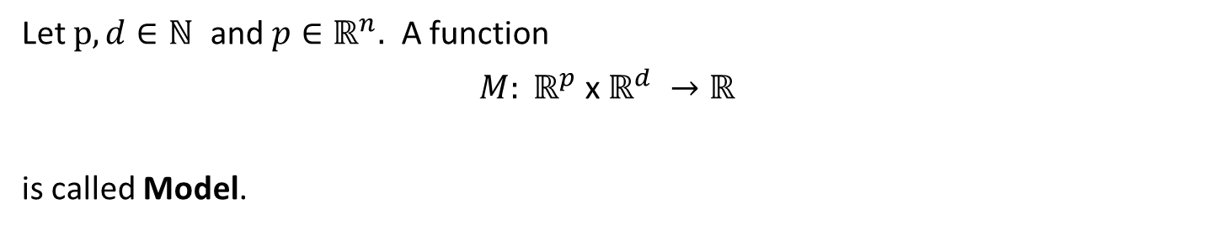
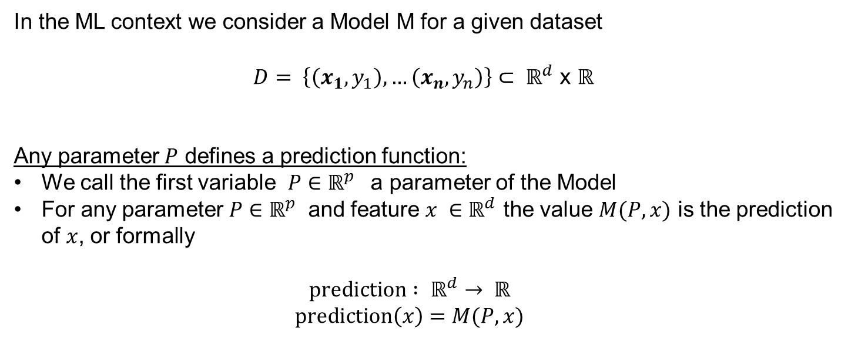
Definition of a Model
Let $p,d∈ℕ$ and $p∈ℝ^{n}.$ A function
$M: ℝ^{p}$ x $ℝ^{d} →ℝ^{}$
is called Model.
In the ML context we consider a Model M for a given dataset
$D= \left\{\left(x_{1},y_{1}\right),…\left(x_{n}, y_{n}\right)\right\}⊂ ℝ^{d}$ x $ℝ^{}$
Any parameter $P$ defines a prediction function:
We call the first variable ${P∈ℝ}^{p}$ a parameter of the Model
For any parameter ${P∈ℝ}^{p}$ and feature ${x ∈ℝ}^{d}$ the value $M(P,x)$ is the prediction of $x$, or formally
$$\text{prediction} : ℝ^{d}→ ℝ$$
$$\text{prediction}\left(x\right)=M(P,x)$$

